Slide 1

Results – Method 1
Experimental investigation of temperatures and heat flows for orthogonal cutting 1045/4140 steel by thermal imaging

Slide 2
Gliederung
1
Experimental Setup
2
Post processing of thermal pictures
3
Orthogonal cutting of AISI 1040 (C45 E+N) normalized
4
Orthogonal cutting of AISI 4140 (41CrMo4) normalized/quenched and tempered

Slide 3
Gliederung
1
Experimental Setup
2
Post processing of thermal pictures
3
Orthogonal cutting of AISI 1040 (C45 E+N) normalized
4
Orthogonal cutting of AISI 4140 (41CrMo4) normalized/quenched and tempered

Slide 4
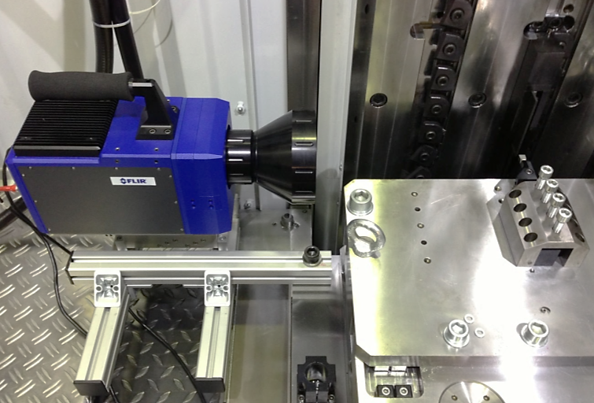
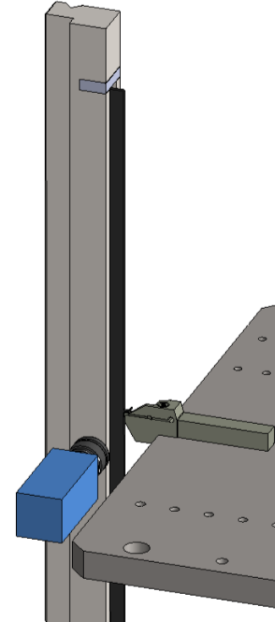
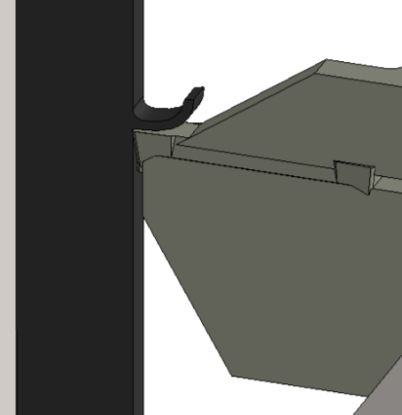
Experimental Setup Design of Experiment
Workpiece
Cutting process
Tool
Thermal camera
Area covered by the thermal camera

Slide 5
Experimental Setup Design of Experiment for AISI 1045
Experiments | Cutting Velocity [m/min] | Uncut chip thickness [µm] | Integration time [µs] | Cutting Force [N] | Passive Force [N] | Heat treatment
VP41_1_H200_V100_C45_MF_425 | 100 | 200 | 425 | 1500 | 1000 | Normalized
VP41_2_H200_V100_C45_MF_425 | 100 | 200 | 425 | 1565 | 1005 | Normalized
VP42_1_H300_V100_C45_MF_425 | 100 | 300 | 425 | 2250 | 1159 | Normalized
VP42_2_H300_V100_C45_MF_285 | 100 | 300 | 285 | 2136 | 1079 | Normalized
VP43_1_H400_V100_C45_MF_285 | 100 | 400 | 285 | 2716 | 1118 | Normalized
VP45_2_H200_V150_C45_MF_425 | 150 | 200 | 425 | 1448 | 688 | Normalized
VP46_1_H300_V150_C45_MF_285 | 150 | 300 | 285 | 2006 | 801 | Normalized
VP46_2_H300_V150_C45_MF_285 | 150 | 300 | 285 | 2004 | 875 | Normalized
VP49_1_H400_V150_C45_MF_285 | 150 | 400 | 285 | 2675 | 1046 | Normalized
VP49_2_H400_V150_C45_MF_285 | 150 | 400 | 285 | 2590 | 1000 | Normalized
VP50_1_H500_V150_C45_MF_285 | 150 | 500 | 285 | 3220 | 1120 | Normalized
VP50_2_H500_V150_C45_MF_285 | 150 | 500 | 285 | 3178 | 1162 | Normalized

Slide 6
Experimental Setup Design of Experiment for AISI 4140 [1/2]
Experiments | Cutting Velocity [m/min] | Uncut chip thickness [µm] | Integration time [µs] | Cutting Force [N] | Passive Force [N] | Heat treatment
VP4_1_H300_V100_ACF_MF_285 | 100 | 300 | 285 | 1520 | 691 | Normalized
VP4_2_H300_V100_ACF_MF_285 | 100 | 300 | 285 | 1560 | 734 | Normalized
VP5_1_H200_V100_ACF_MF_285 | 100 | 200 | 285 | 1105 | 556 | Normalized
VP5_2_H200_V100_ACF_MF_285 | 100 | 200 | 285 | 1113 | 546 | Normalized
VP6_1_H100_V100_ACF_MF_285 | 100 | 100 | 285 | 619 | 361 | Normalized
VP32_1_H200_V150_ACF_MF_285 | 150 | 200 | 285 | 1133 | 519 | Normalized
VP32_2_H200_V150_ACF_MF_285 | 150 | 200 | 285 | 1054 | 496 | Normalized
VP33_1_H300_V150_ACF_MF_285 | 150 | 300 | 285 | 1495 | 538 | Normalized
VP36_1_H200_V100_ABA_MF_285 | 100 | 200 | 285 | 1302 | 400 | Tempered
VP36_2_H200_V100_ABA_MF_425 | 100 | 200 | 425 | 1242 | 436 | Tempered
VP36_3_H200_V100_ABA_MF_425 | 100 | 200 | 425 | 1295 | 410 | Tempered
VP37_1_H200_V150_ABA_MF_425 | 150 | 200 | 425 | 1225 | 373 | Tempered

Slide 7
Experimental Setup Design of Experiment for AISI 4140 [2/2]
Experiments | Cutting Velocity [m/min] | Uncut chip thickness [µm] | Integration time [µs] | Cutting Force [N] | Passive Force [N] | Heat treatment
VP37_2_H200_V150_ABA_MF_425 | 150 | 200 | 425 | 1260 | 362 | Tempered
VP38_1_H300_V100_ABA_MF_425 | 100 | 300 | 425 | 1846 | 1574 | Tempered
VP38_2_H300_V100_ABA_MF_425 | 100 | 300 | 425 | 2028 | 1633 | Tempered
VP39_1_H300_V150_ABA_MF_425 | 150 | 300 | 425 | 1892 | 1576 | Tempered
VP39_2_H300_V150_ABA_MF_425 | 150 | 300 | 425 | 1936 | 1820 | Tempered

Slide 8
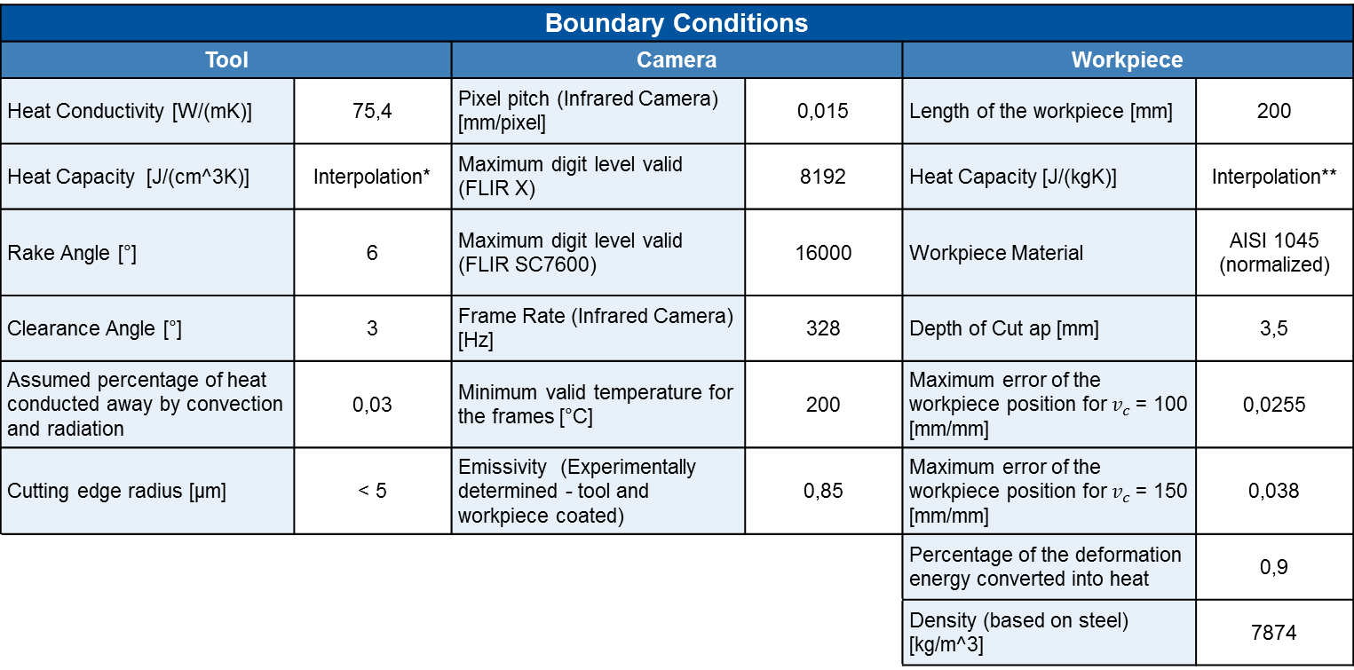
Experimental Setup Boundary Conditions for AISI 1045
Boundary Conditions
Tool |  | Camera |  | Workpiece
Heat Conductivity [W/(mK)] | 75,4 | Pixel pitch (Infrared Camera) [mm/pixel] | 0,015 | Length of the workpiece [mm] | 200
Heat Capacity [J/(cm^3K)] | Interpolation* | Maximum digit level valid (FLIR X) | 8192 | Heat Capacity [J/(kgK)] | Interpolation**
Rake Angle [°] | 6 | Maximum digit level valid (FLIR SC7600) | 16000 | Workpiece Material | AISI 1045 (normalized)
Clearance Angle [°] | 3 | Frame Rate (Infrared Camera) [Hz] | 328 | Depth of Cut ap [mm] | 3,5
Assumed percentage of heat conducted away by convection and radiation | 0,03 | Minimum valid temperature for the frames [°C] | 200 | Maximum error of the workpiece position for $v_{c}$ = 100 [mm/mm] | 0,0255
Cutting edge radius [µm] | < 5 | Emissivity (Experimentally determined - tool and workpiece coated) | 0,85 | Maximum error of the workpiece position for $v_{c}$ = 150 [mm/mm] | 0,038
 |  |  |  | Percentage of the deformation energy converted into heat | 0,9
 |  |  |  | Density (based on steel) [kg/m^3] | 7874
Interpolation
*Tool [J/(cm^3K)]
$$c_{p}\left(T\right)=2,51∗{10}^{−10}T^{3}−1,99∗{10}^{−6}T^{2}+0,0027T+3,09$$
**Workpiece [J/(kgK)]
$$c_{p}\left(T\right)=−4,39∗{10}^{−7}T^{3}−7,07∗{10}^{−4}T^{2}+0,0489T+481,21$$

Slide 9

Experimental Setup Boundary Conditions for AISI 4140
Boundary Conditions
Tool |  | Camera |  | Workpiece
Heat Conductivity [W/(mK)] | 75,4 | Pixel pitch (Infrared Camera) [mm/pixel] | 0,015 | Length of the workpiece [mm] | 80
Heat Capacity [J/(cm^3K)] | Interpolation* | Maximum digit level valid (FLIR X) | 8192 | Heat Capacity [J/(kgK)] | Interpolation**
Rake Angle [°] | 6 | Maximum digit level valid (FLIR SC7600) | 16000 | Workpiece Material | AISI 4140 (normalized / tempered)
Clearance Angle [°] | 3 | Frame Rate (Infrared Camera) [Hz] | 328 | Depth of Cut ap [mm] | 2,8
Assumed percentage of heat conducted away by convection and radiation | 0,03 | Minimum valid temperature for the frames [°C] | 200 | Maximum error of the workpiece position for $v_{c}$ = 100 [mm/mm] | 0,064
Cutting edge radius [µm] | 66 | Emissivity (Experimentally determined - tool and workpiece coated) | 0,85 | Maximum error of the workpiece position for $v_{c}$ = 150 [mm/mm] | 0,095
 |  |  |  | Percentage of the deformation energy converted into heat | 0,9
 |  |  |  | Density (based on steel) [kg/m^3] | 7874
Interpolation
*Tool [J/(cm^3K)]
$$c_{p}\left(T\right)=2,51∗{10}^{−10}T^{3}−1,99∗{10}^{−6}T^{2}+0,0027T+3,09$$
**Workpiece [J/(kgK)]
$$c_{p}\left(T\right)=−5∗{10}^{−5}T^{2}+0,257T+429,4$$

Slide 10
Gliederung
1
Experimental Setup
2
Post processing of thermal pictures
3
Orthogonal cutting of AISI 1040 (C45 E+N) normalized
4
Orthogonal cutting of AISI 4140 (41CrMo4) normalized/quenched and tempered

Slide 11
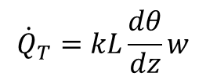
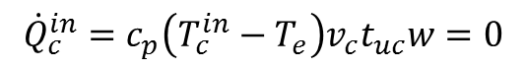
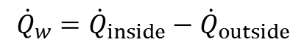
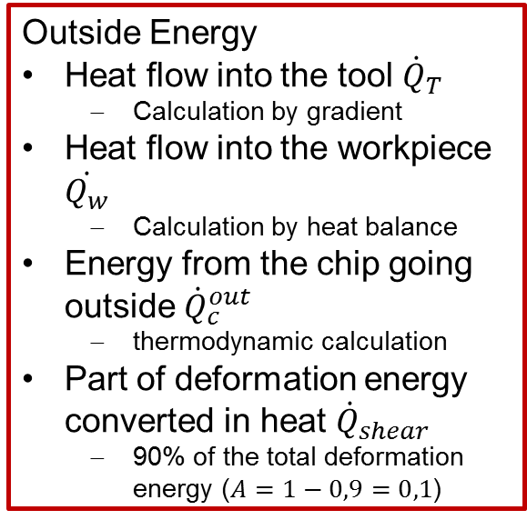
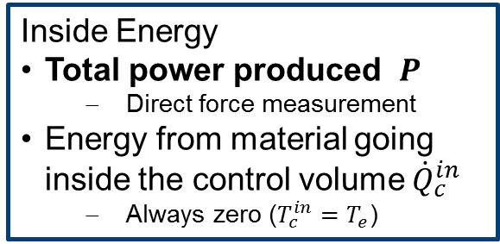

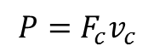
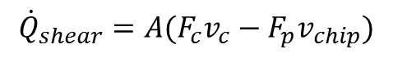
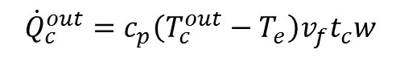
Post processing of thermal pictures Energy balance in the volume control
Inside Energy
Total power produced $P$
Direct force measurement
Energy from material going inside the control volume ${\dot{Q}}_{c}^{in}$
Always zero ($T_{c}^{in}=T_{e}$)
$${\dot{Q}}_{c}^{out}=c_{p}\left(T_{c}^{out}−T_{e}\right)v_{f}t_{c}w$$
$${\dot{Q}}_{T}=kL\frac{dθ}{dz}w$$
$${\dot{Q}}_{shear}=A(F_{c}v_{c}−F_{p}v_{chip})$$
Outside Energy
Heat flow into the tool ${\dot{Q}}_{T}$
Calculation by gradient
Heat flow into the workpiece $\dot{Q_{w}}$
Calculation by heat balance
Energy from the chip going outside ${\dot{Q}}_{c}^{out}$
thermodynamic calculation
Part of deformation energy converted in heat ${\dot{Q}}_{shear}$
90% of the total deformation energy ($A=1−0,9=0,1$)
$$P=F_{c}v_{c}$$
Chip
Tool
$${\dot{Q}}_{c}^{in}=c_{p}\left(T_{c}^{in}−T_{e}\right)v_{c}t_{uc}w=0$$
Workpiece
$${\dot{Q}}_{w}={\dot{Q}}_{inside}−{\dot{Q}}_{outside}$$
Control volume
*${\dot{Q}}_{inside}=\sum{Heat flow going inside}$,${\dot{Q}}_{outside}=\sum{Heat flowgoing outside }$
Notes:
In this analysis, the energy flows considered for the volume control are listed above. Then, with the temperature field of the Infrared camera frames, this analysis is able to calculate the heat flow through the tool and the chip and, consequently, the heat partition of the total power produced during the process. About 90% of the deformation energy is converted in heat and the heat flow through the workpiece is calculated by the total balance.

Slide 12
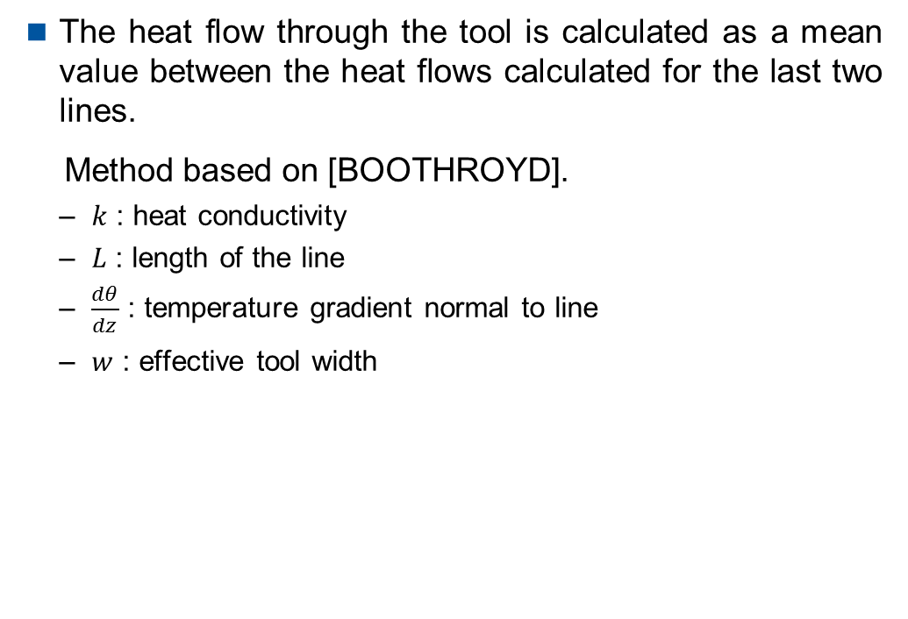
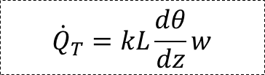
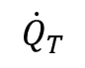
Post processing of thermal pictures Heat carried away from the tool tip
The heat flow through the tool is calculated as a mean value between the heat flows calculated for the last two lines.
Method based on [BOOTHROYD].
$k$ : heat conductivity
$L$ : length of the line
$\frac{dθ}{dz}$ : temperature gradient normal to line
$w$ : effective tool width
$${\dot{Q}}_{T}$$
$${\dot{Q}}_{T}=kL\frac{dθ}{dz}w$$
Tool

Slide 13
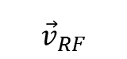
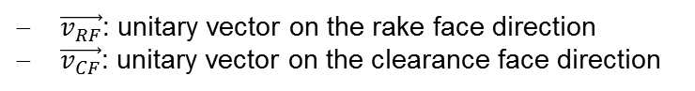
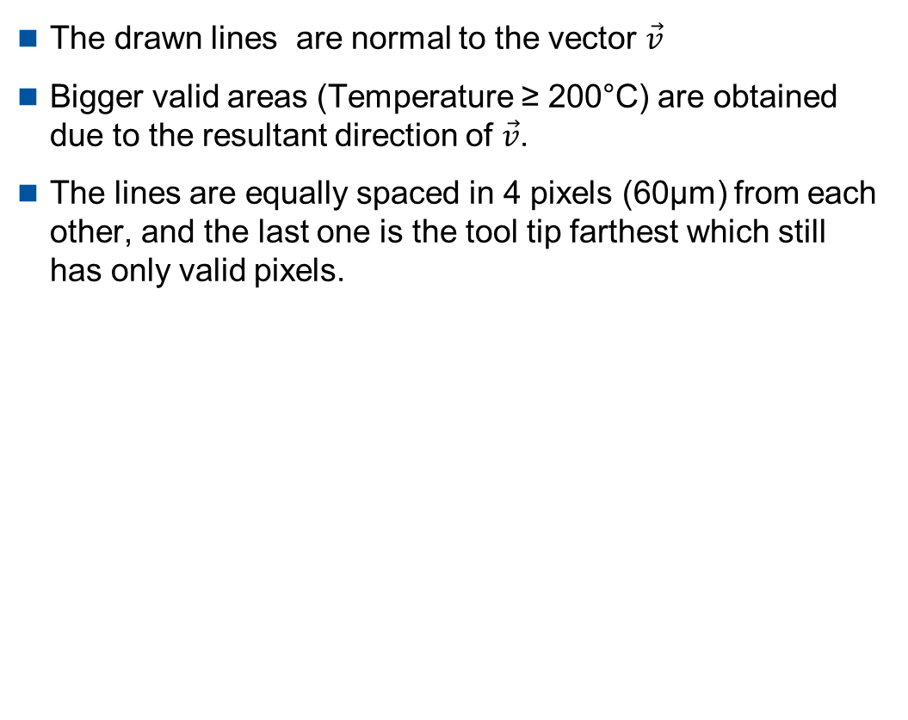
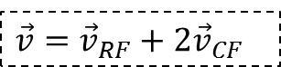

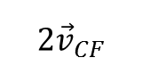
Post processing of thermal pictures Lines along the tool – obtaining process
The drawn lines are normal to the vector $\vec{v}$
Bigger valid areas (Temperature ≥ 200°C) are obtained due to the resultant direction of $\vec{v}$.
The lines are equally spaced in 4 pixels (60µm) from each other, and the last one is the tool tip farthest which still has only valid pixels.
$\vec{v}=$ ${\vec{v}}_{RF}+2{\vec{v}}_{CF}$
$$\vec{v}$$
$${\vec{v}}_{RF}$$
$$2{\vec{v}}_{CF}$$
$\vec{v_{RF}}$: unitary vector on the rake face direction
$\vec{v_{CF}}$: unitary vector on the clearance face direction

Slide 14
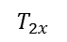
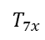
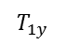
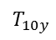
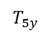
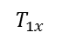
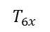
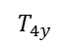
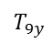
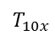
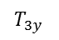
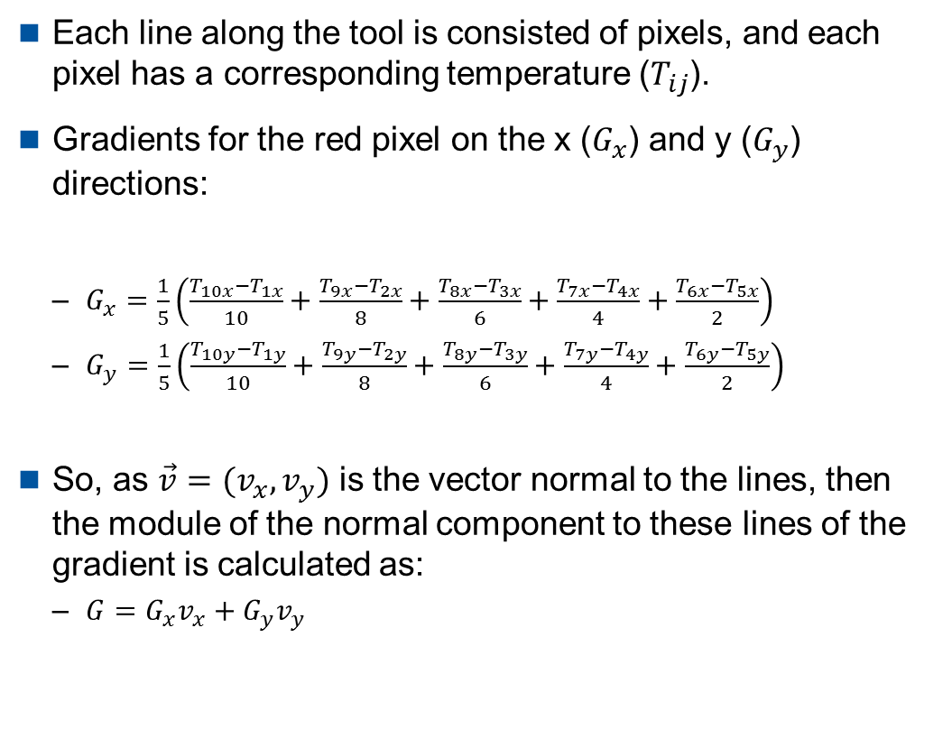
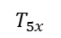
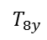
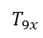
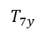
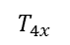
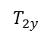
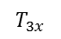
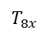
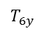

Post processing of thermal pictures Temperature gradient – calculation method
Each line along the tool is consisted of pixels, and each pixel has a corresponding temperature ($T_{ij}$).
Gradients for the red pixel on the x ($G_{x}$) and y ($G_{y}$) directions:
$G_{x}=\frac{1}{5}\left(\frac{T_{10x}−T_{1x}}{10}+\frac{T_{9x}−T_{2x}}{8}+\frac{T_{8x}−T_{3x}}{6}+\frac{T_{7x}−T_{4x}}{4}+\frac{T_{6x}−T_{5x}}{2}\right)$
$G_{y}=\frac{1}{5}\left(\frac{T_{10y}−T_{1y}}{10}+\frac{T_{9y}−T_{2y}}{8}+\frac{T_{8y}−T_{3y}}{6}+\frac{T_{7y}−T_{4y}}{4}+\frac{T_{6y}−T_{5y}}{2}\right)$
So, as $\vec{v}=(v_{x},v_{y})$ is the vector normal to the lines, then the module of the normal component to these lines of the gradient is calculated as:
$G=G_{x}v_{x}+G_{y}v_{y}$
Tool
$$T_{1y}$$
$$T_{2y}$$
$$T_{3y}$$
$$T_{4y}$$
$$T_{5y}$$
$$T_{1x}$$
$$T_{2x}$$
$$T_{3x}$$
$$T_{4x}$$
$$T_{5x}$$
$$T_{6x}$$
$$T_{7x}$$
$$T_{8x}$$
$$T_{9x}$$
$$T_{10x}$$
$$T_{6y}$$
$$T_{7y}$$
$$T_{8y}$$
$$T_{9y}$$
$$\vec{v}$$
$$T_{10y}$$

Slide 15
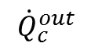
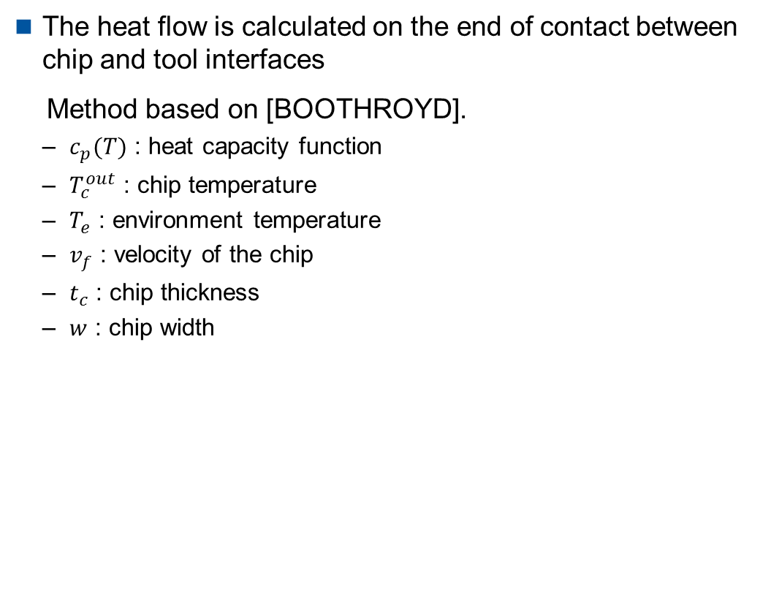
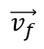
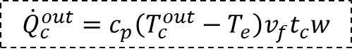
Post processing of thermal pictures Heat carried away by the chip
The heat flow is calculated on the end of contact between chip and tool interfaces
Method based on [BOOTHROYD].
$c_{p}(T)$ : heat capacity function
$T_{c}^{out}$ : chip temperature
$T_{e}$ : environment temperature
$v_{f}$ : velocity of the chip
$t_{c}$ : chip thickness
$w$ : chip width
$${\dot{Q}}_{c}^{out}$$
End of contact chip - tool
$$\vec{v_{f}}$$
$${\dot{Q}}_{c}^{out}=c_{p}\left(T_{c}^{out}−T_{e}\right)v_{f}t_{c}w$$
Chip
Tool

Slide 16
Gliederung
1
Experimental Setup
2
Post processing of thermal pictures
3
Orthogonal cutting of AISI 1040 (C45 E+N) normalized
3.1
Time and spatial varying thermal properties
3.2
Influence of uncut chip thickness and cutting velocity
4
Orthogonal cutting of AISI 4140 (41CrMo4) normalized/quenched and tempered

Slide 17
Time and spatial varying thermal properties Temperature at tool tip [°C] for different v_{c} and h_{sp}

Slide 18
Time and spatial varying thermal properties Internal energy in tool [Joule] for different v_{c} and h_{sp}
Notes:
The higher the chip thickness the higher the internal energy/heat rate
The lower the cutting speed the higher the internal energy in the tool → High Speed cutting

Slide 19
Time and spatial varying thermal properties Internal energy rate of the tool [W] for different v_{c} and h_{sp}
Notes:
Heating rate rises with chip thickness
Heating rate decreases with cutting speed
H/v → Heating rate
1,33
2
4
2
3
2,66
3,333

Slide 20
Time and spatial varying thermal properties Internal energy carried away by chip [W] for different v_{c} and h_{sp}
Notes:
Heat carried away by chip rises with hsp*vc
Heat carried away by chip increases with cutting length for small chip thickness
Why?????
v_{c*} h_{sp} ~ ${\dot{ q}}^{´}$_{chip} ; l_{c} ↑ → ${\dot{ q}}^{´}$_{chip} = const. (gilt nicht für Vp41 , VP42)
${\dot{ q}}^{´}$_{chip} ↑ → B_{chip} ↑ (für Vp41 , VP42)

Slide 21
Time and spatial varying thermal properties Heat partition to the chip for different v_{c} and h_{sp}
Notes:
No influence of level of heat partition inside the chip by chip thickness
Rising heat partition inside the chip, especially for lower chip thickness → Hypo: tool is heating up and is conducts less heat away
Hypo: The lower the chip thickness the lower the influence of friction at the rake face
1 = B_{chip} + B_{tool} + B_{WP}
B_{tool} = konst. ; B_{chip} ↑ → B_{WP} ↓

Slide 22
Time and spatial varying thermal properties Heat flow into the tool [W] for different v_{c} and h_{sp}

Slide 23
Time and spatial varying thermal properties Heat flow into the tool [W] for different v_{c} and h_{sp} 2
Notes:
For small chip thickness no influence of cutting speed
Heat flux into the tool rises with chip thickness decreasingly,
Less rise for smaller cutting speeds
Decreases for higher chip thickness over time constant for small chip thickness hypo: tool gets to hot to carry heat away
Hypo: The higher the chip thickness the higher the frictional influence
Thermal number? Vc *hsp??

Slide 24
Time and spatial varying thermal properties Heat partition into the tool for different v_{c} and h_{sp}
Notes:
Heat partition inside tool higher for low cutting speed → Puls
No influence of chip thickness → Puls
Remains constant over time

Slide 25
Time and spatial varying thermal properties Heat flow into the workpiece [W] for different v_{c} and h_{sp}
Notes:
Heat flux inside work piece decreases with cutting speed and chip thickness
Heat flux into workpiece decreases over cutting length for small chip thickness
How over time?
How is this possible?

Slide 26
Time and spatial varying thermal properties Heat partition into the workpiece for different v_{c} and h_{sp}
Notes:
Heat partition into workpiece independent from vc and hsp does not fit to K&H
Decreases for small chip thickness

Slide 27
Time and spatial varying thermal properties Friction coefficient µ for different v_{c} and h_{sp}

Slide 28
Time and spatial varying thermal properties Heat partition ratios for h_{sp} = 200 µm, v_{c} = 100 m/min
Chip
Workpiece
Tool

Slide 29
Temperature distribution for orthogonal cutting Temperature distribution for h_{sp} = 200 µm, v_{c} = 100 m/min
Workpiece position : 124 mm
Workpiece position : 200 mm
[°C]

Slide 30
Time and spatial varying thermal properties Heat partition ratios for h_{sp} = 200 µm, v_{c} = 150 m/min
Chip
Workpiece
Tool

Slide 31
Time and spatial varying thermal properties Temperature distribution for h_{sp} = 200 µm, v_{c} = 150 m/min
Workpiece position : 124 mm
Workpiece position : 200 mm
[°C]
Notes:
With higher cutting speed and lower chip thickness more heat is transferred over tip

Slide 32
Time and spatial varying thermal properties Heat partition ratios for h_{sp} = 300 µm, v_{c} = 100 m/min
Chip
Workpiece
Tool

Slide 33
Time and spatial varying thermal properties Temperature distribution for h_{sp} = 300 µm, v_{c} = 100 m/min
Workpiece position : 124 mm
Workpiece position : 200 mm
[°C]

Slide 34
Time and spatial varying thermal properties Heat partition ratios for h_{sp} = 300 µm, v_{c} = 150 m/min
Chip
Workpiece
Tool

Slide 35
Time and spatial varying thermal properties Temperature distribution for h_{sp} = 300 µm, v_{c} = 150 m/min
Workpiece position : 124 mm
Workpiece position : 200 mm
[°C]

Slide 36
Time and spatial varying thermal properties Heat partition ratios for h_{sp} = 400 µm, v_{c} = 100 m/min
Chip
Workpiece
Tool

Slide 37
Time and spatial varying thermal properties Heat partition ratios for h_{sp} = 400 µm, v_{c} = 150 m/min
Chip
Workpiece
Tool

Slide 38
Time and spatial varying thermal properties Temperature distribution for h_{sp} = 400 µm, v_{c} = 150 m/min [1/2]
Workpiece position : 124 mm
Workpiece position : 200 mm
[°C]

Slide 39
Time and spatial varying thermal properties Temperature distribution for h_{sp} = 400 µm, v_{c} = 150 m/min [2/2]
Workpiece position : 124 mm
Workpiece position : 200 mm
[°C]

Slide 40
Time and spatial varying thermal properties Heat partition ratios for h_{sp} = 500 µm, v_{c} = 150 m/min
Chip
Workpiece
Tool

Slide 41
Time and spatial varying thermal properties Temperature distribution for h_{sp} = 500 µm, v_{c} = 150 m/min
Workpiece position : 124 mm
Workpiece position : 200 mm
[°C]

Slide 42
Time and spatial varying thermal properties Conclusion
XYZ

Slide 43
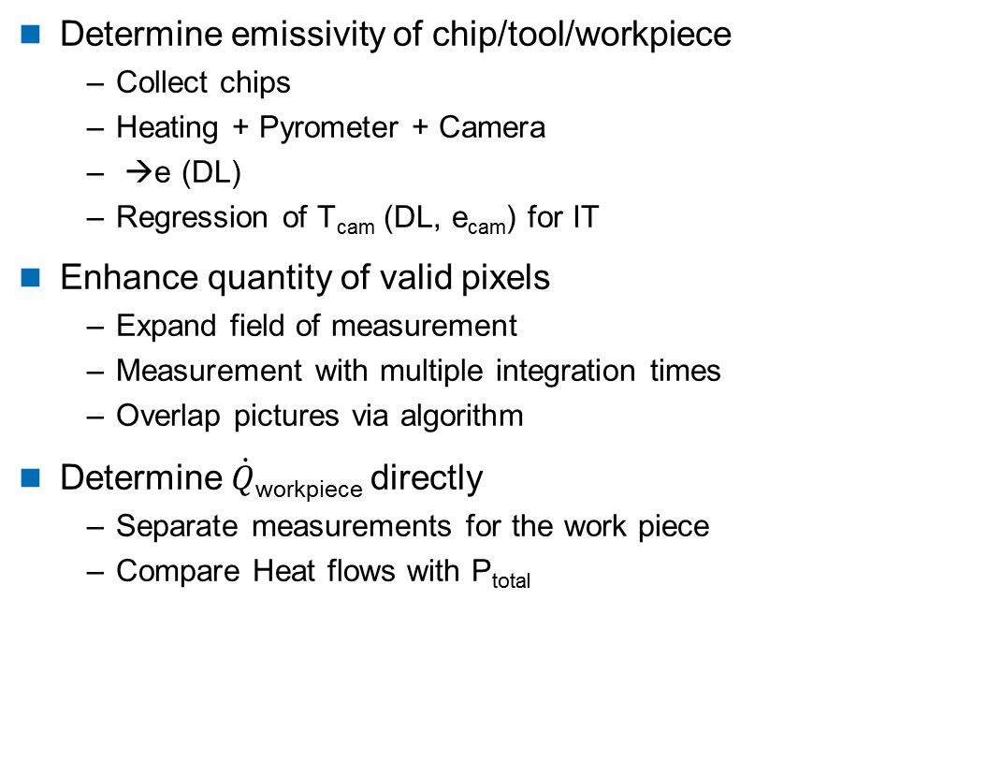
Time and spatial varying thermal properties Means to enhance quality of measurement
Determine emissivity of chip/tool/workpiece
Collect chips
Heating + Pyrometer + Camera
→e (DL)
Regression of T_{cam} (DL, e_{cam}) for IT
Enhance quantity of valid pixels
Expand field of measurement
Measurement with multiple integration times
Overlap pictures via algorithm
Determine $\dot{Q}$_{workpiece} directly
Separate measurements for the work piece
Compare Heat flows with P_{total}

Slide 44
Gliederung
1
Experimental Setup
2
Post processing of thermal pictures
3
Orthogonal cutting of AISI 1040 (C45 E+N) normalized
3.1
Time and spatial varying thermal properties
3.2
Influence of uncut chip thickness and cutting velocity
4
Orthogonal cutting of AISI 4140 (41CrMo4) normalized/quenched and tempered

Slide 45
Influence of uncut chip thickness and cutting velocity Workpiece position 124 mm
a_{p} = 3,5 mm, $γ$ = 6°, $α$ = 3°, $r_{β}$ < 5 µm, uncoated, workpiece position: 124 mm
h_{sp} [µm]
Cutting velocity [m/min]

Slide 46
Influence of uncut chip thickness and cutting velocity Workpiece position 200 mm
a_{p} = 3,5 mm, $γ$ = 6°, $α$ = 3°, $r_{β}$ < 5 µm, uncoated, workpiece position: 200 mm
h_{sp} [µm]
Cutting velocity [m/min]

Slide 47
Gliederung
1
Experimental Setup
2
Post processing of thermal pictures
3
Orthogonal cutting of AISI 1040 (C45 E+N) normalized
4
Orthogonal cutting of AISI 4140 (41CrMo4) normalized/quenched and tempered
4.1
Time and spatial varying thermal properties
4.2
Influence of uncut chip thickness and cutting velocity

Slide 48
Gliederung
1
Experimental Setup
2
Post processing of thermal pictures
3
Orthogonal cutting of AISI 1040 (C45 E+N) normalized
4
Orthogonal cutting of AISI 4140 (41CrMo4) normalized/quenched and tempered
4.1
Time and spatial varying thermal properties
4.2
Influence of uncut chip thickness and cutting velocity

Slide 49
Time and spatial varying thermal properties Temperature at tool tip [°C] for different v_{c} and h_{sp}

Slide 50
Time and spatial varying thermal properties Internal energy in tool [Joule] for different v_{c} and h_{sp}

Slide 51
Time and spatial varying thermal properties Internal energy rate of the tool [W] for different v_{c} and h_{sp}

Slide 52
Time and spatial varying thermal properties Internal energy carried away by chip [W] for different v_{c} and h_{sp}

Slide 53
Time and spatial varying thermal properties Heat partition to the chip for different v_{c} and h_{sp}

Slide 54
Time and spatial varying thermal properties Heat flow into the tool [W] for different v_{c} and h_{sp}

Slide 55
Time and spatial varying thermal properties Heat partition into the tool for different v_{c} and h_{sp}

Slide 56
Time and spatial varying thermal properties Heat flow into the workpiece [W] for different v_{c} and h_{sp}

Slide 57
Time and spatial varying thermal properties Heat partition into the workpiece for different v_{c} and h_{sp}

Slide 58
Time and spatial varying thermal properties Friction coefficient µ for different v_{c} and h_{sp}

Slide 59
Time and spatial varying thermal properties Heat partition ratios for h_{sp} = 100 µm, v_{c} = 100 m/min (ACF)
Chip
Workpiece
Tool

Slide 60
Time and spatial varying thermal properties Temperature distribution for h_{sp} = 100 µm, v_{c} = 100 m/min (ACF)
Workpiece position : 49,51 mm
Workpiece position : 80 mm
[°C]

Slide 61
Time and spatial varying thermal properties Heat partition ratios for h_{sp} = 200 µm, v_{c} = 100 m/min (ACF)
Chip
Workpiece
Tool

Slide 62
Time and spatial varying thermal properties Temperature distribution for h_{sp} = 200 µm, v_{c} = 100 m/min (ACF)
Workpiece position : 34,27 mm
Workpiece position : 80 mm
[°C]

Slide 63
Time and spatial varying thermal properties Heat partition ratios for h_{sp} = 300 µm, v_{c} = 100 m/min (ACF)
Chip
Workpiece
Tool

Slide 64
Time and spatial varying thermal properties Temperature distribution for h_{sp} = 300 µm, v_{c} = 100 m/min (ACF)
Workpiece position : 34,27 mm
Workpiece position : 80 mm
[°C]

Slide 65
Time and spatial varying thermal properties Heat partition ratios for h_{sp} = 200 µm, v_{c} = 150 m/min (ACF)
Chip
Workpiece
Tool

Slide 66
Time and spatial varying thermal properties Temperature distribution for h_{sp} = 200 µm, v_{c} = 150 m/min (ACF)
Workpiece position : 34,27 mm
Workpiece position : 80 mm
[°C]

Slide 67
Time and spatial varying thermal properties Heat partition ratios for h_{sp} = 300 µm, v_{c} = 150 m/min (ACF)
Chip
Workpiece
Tool

Slide 68
Time and spatial varying thermal properties Temperature distribution for h_{sp} = 300 µm, v_{c} = 150 m/min (ACF)
Workpiece position : 34,27 mm
Workpiece position : 80 mm
[°C]

Slide 69
Time and spatial varying thermal properties Heat partition ratios for h_{sp} = 200 µm, v_{c} = 100 m/min (ABA)
Chip
Workpiece
Tool

Slide 70
Time and spatial varying thermal properties Temperature distribution for h_{sp} = 200 µm, v_{c} = 100 m/min (ABA)
Workpiece position : 34,27 mm
Workpiece position : 80 mm
[°C]

Slide 71
Time and spatial varying thermal properties Heat partition ratios for h_{sp} = 200 µm, v_{c} = 150 m/min (ABA)
Chip
Workpiece
Tool

Slide 72
Time and spatial varying thermal properties Temperature distribution for h_{sp} = 200 µm, v_{c} = 150 m/min (ABA)
Workpiece position : 34,27 mm
Workpiece position : 80 mm
[°C]

Slide 73
Time and spatial varying thermal properties Heat partition ratios for h_{sp} = 300 µm, v_{c} = 100 m/min (ABA)
Chip
Workpiece
Tool

Slide 74
Time and spatial varying thermal properties Temperature distribution for h_{sp} = 300 µm, v_{c} = 100 m/min (ABA)
Workpiece position : 34,27 mm
Workpiece position : 80 mm
[°C]

Slide 75
Time and spatial varying thermal properties Heat partition ratios for h_{sp} = 300 µm, v_{c} = 150 m/min (ABA)
Chip
Workpiece
Tool

Slide 76
Time and spatial varying thermal properties Temperature distribution for h_{sp} = 300 µm, v_{c} = 150 m/min (ABA)
Workpiece position : 34,27 mm
Workpiece position : 80 mm
[°C]

Slide 77
Gliederung
1
Experimental Setup
2
Post processing of thermal pictures
3
Orthogonal cutting of AISI 1040 (C45 E+N) normalized
4
Orthogonal cutting of AISI 4140 (41CrMo4) normalized/quenched and tempered
4.1
Time and spatial varying thermal properties
4.2
Influence of uncut chip thickness and cutting velocity

Slide 78
Influence of uncut chip thickness and cutting velocity Workpiece position 34 mm (ACF)
a_{p} = 2,8 mm, $γ$ = 6°, $α$ = 3°, $r_{β}$ = 66 µm, normalized, uncoated, workpiece position: 34mm
h_{sp} [µm]

Slide 79
Influence of uncut chip thickness and cutting velocity Workpiece position 80 mm (ACF)
a_{p} = 2,8 mm, $γ$ = 6°, $α$ = 3°, $r_{β}$ = 66 µm, normalized, uncoated, workpiece position: 80 mm
h_{sp} [µm]

Slide 80
Influence of uncut chip thickness and cutting velocity Workpiece position 34 mm (ABA)
a_{p} = 2,8 mm, $γ$ = 6°, $α$ = 3°, $r_{β}$ = 66 µm, tempered, uncoated, workpiece position: 34 mm
h_{sp} [µm]

Slide 81
Influence of uncut chip thickness and cutting velocity Workpiece position 80 mm (ABA)
a_{p} = 2,8 mm, $γ$ = 6°, $α$ = 3°, $r_{β}$ = 66 µm, tempered, uncoated, workpiece position: 80 mm
h_{sp} [µm]

